Slide 1
Handout
Of Flexbox

Slide 2


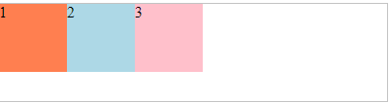
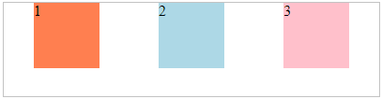
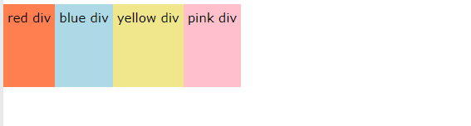
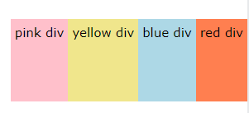
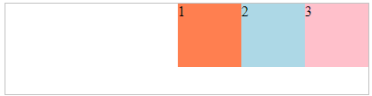
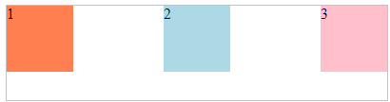
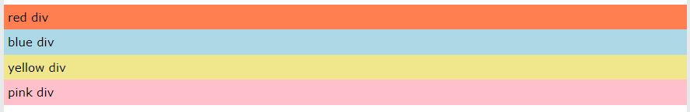
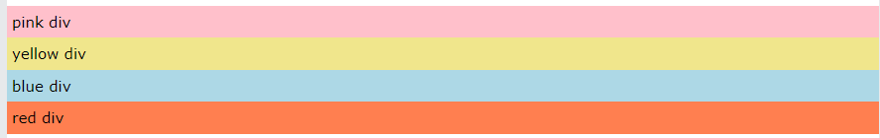
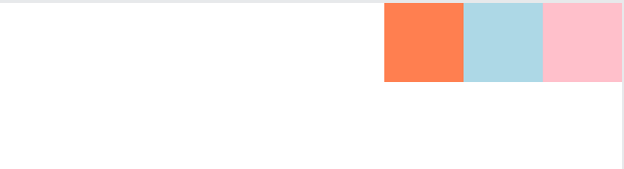
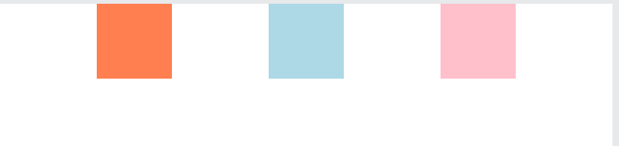
Flex-direction
Justify-content
Flex-direction is property specifies the direction of the flexible items.
Justify-content is properties that align flexible container’s items
Flex-start(by default
Space around
Row(By default)
Row-reverse
Flex-end
Space between
Column
Column-revers
Flex-center
Space evenly

Slide 3


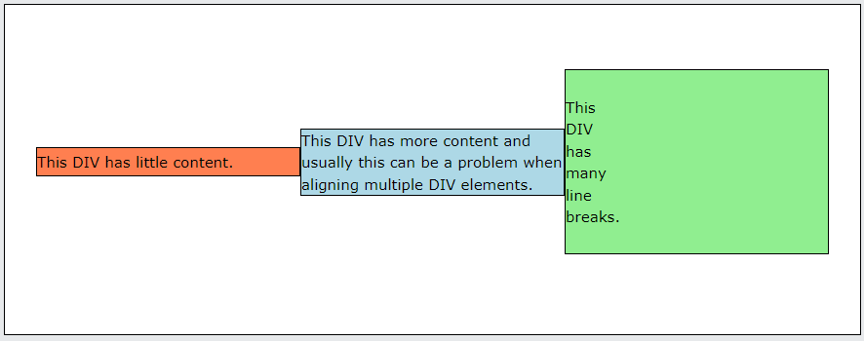
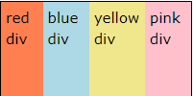
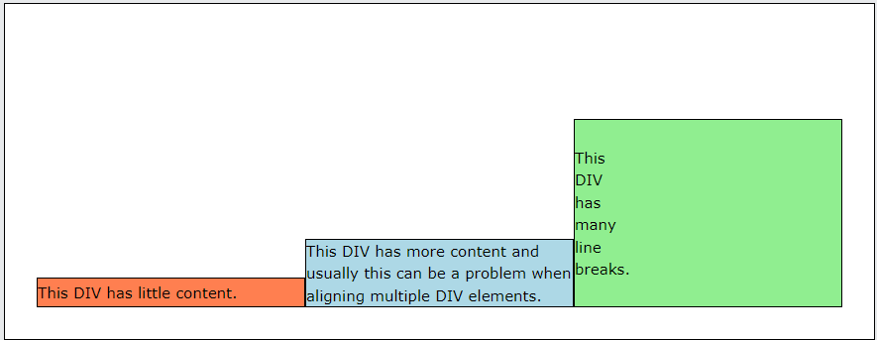
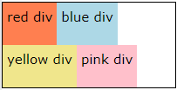
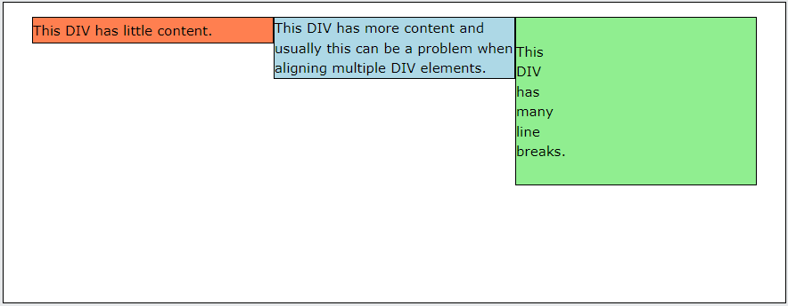
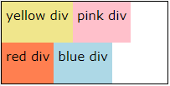
Align-item
Flex-wrap
Align-items property specifies the default alignment for items inside a flexbox or grid container.
flex-wrap property specifies whether the flexible items should wrap or not.
Align-center
nowrap
Align-end
wrap
Align-start
Wrap-reverse

Slide 4
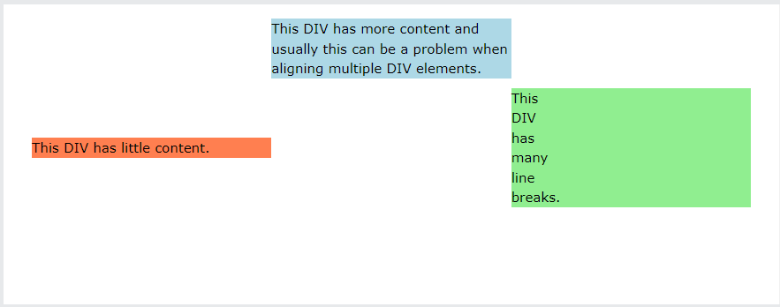
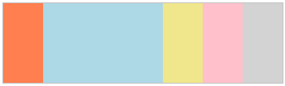
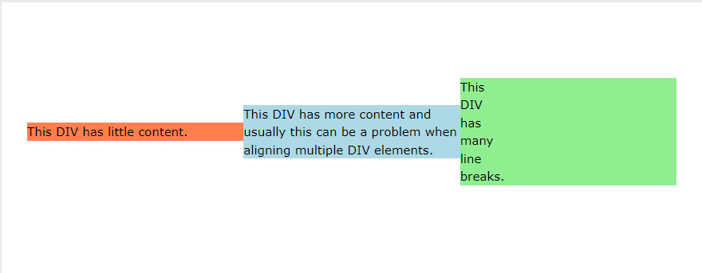
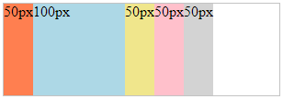
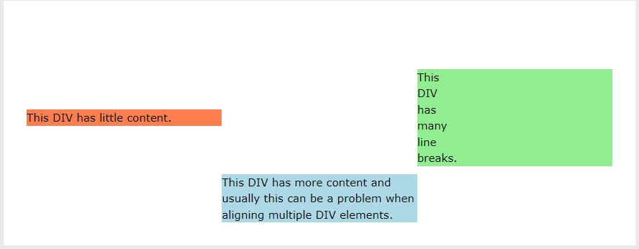
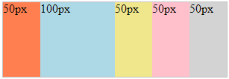
Align-self
Flex
The align-self property specifies the alignment in the block direction for the selected item inside a flexbox or grid container.
The flex property is a shorthand property for:
Align-start
Flex-grow
Align-center
Flex-shrink
Align-end
Flex-basis

